Slide 1

Classes and Objects
OBJECT-ORIENTED PROGRAMMING DEPARTMENT OF INFORMATION TECHNOLOGY MALANG STATE POLYTECHNIC

Slide 2
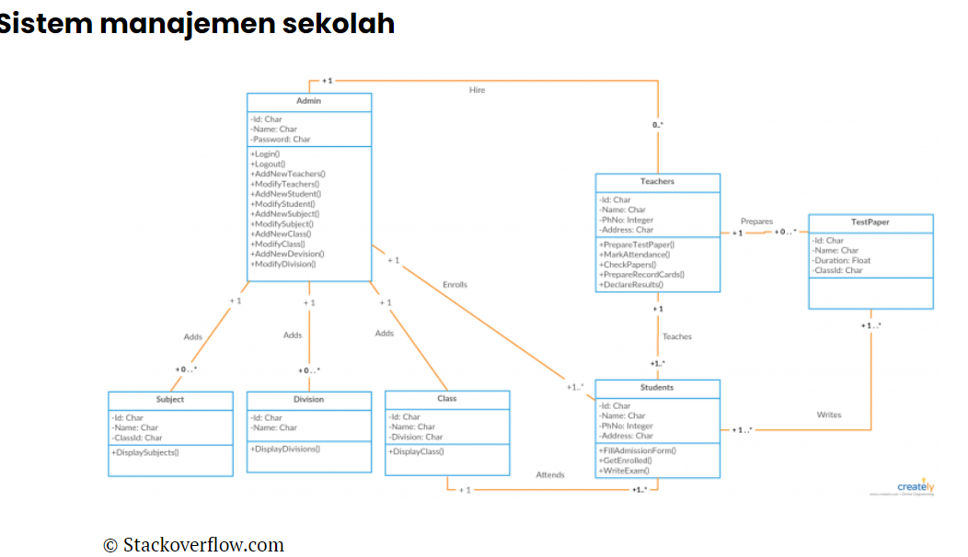
— SCHOOL MANAGEMENT SYSTEM
https://glints.com/id/lowongan/class-diagram-adalah/

Slide 3
— OBJECT
An object is a representation of every entity involved in the system

Slide 4
— CLASS
Blueprints/templates/templates that define the characteristics (attributes and methods) of objects in a given class.

Slide 5
What does it have?
CHARACTERISTIC
What can be done?

Slide 6

What does a student object have?
Name NIM Date of Birth Gender Address
—ATRIBUT: Variables/traits/states/properties owned by an object

Slide 7
What can be done by/against the student object?
—METHOD: Procedures/functions/behaviors/processes that can be performed by/on an object
Choosing a course View grades Apply for academic leave

Slide 8
Rules for writing class names
Is it possible to write a class starting with number? Underscore?

Slide 9
Rules for writing class names
In the form of a noun Starting with CAPITAL LETTERS, If it consists of more than 1 word, then each word is concatenated, and the initial letter of each word uses CAPITAL LETTERS Example: Student, EducationPersonnel

Slide 10
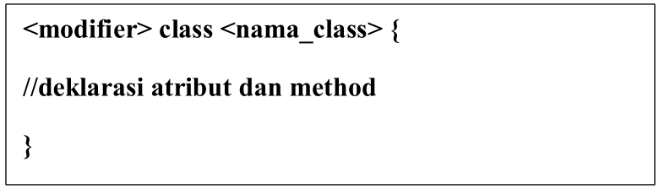
Class Implementation
To declare a class, the keyword class is used and then followed by the name of the class to be created, e.g.:
public class Students{ }

Slide 11
Rules for writing attribute names
In the form of nouns or adjectives, Starts with LOWERCASE If it consists of more than 1 word, then each word is concatenated, and the initial letter of each word uses UPPERCASE.
For e.g :
public String nim;

Slide 12

Attribute Declaration
To declare an attribute:
Exp :
public String nim;
public String name;
public String address;

Slide 13
Rules for writing method names
In the form of verbs, Starting with a LOWERCASE LETTER, If it consists of more than 1 word, then each word is concatenated, and the initial letter of each word uses UPPERCASE.

Slide 14
Declaration Method
To declare a method can be done with the following syntax: <modifier> <return_type> < method name>(param1, param2, …)
{
//statements
}

Slide 15
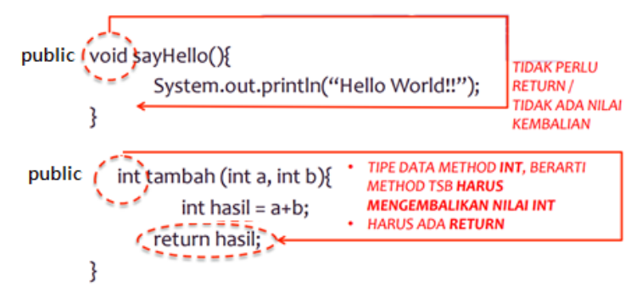

Slide 16
Return Type
A method with a return type void means that it does not have a return value, so it does not require a return keyword in it. Methods with a return type other than void mean that they require a return value, so there must be a value returned with the return keyword in it

Slide 17
Constructor
A special method constructor used to instantiate an object (create a new object), special :
The method name is the same as the class name Does not have a return type Can only be executed/invoked on the instancing process If a class does not have a constructor explicitly, then by default the Java compiler will provide a constructor without a paremeter

Slide 18
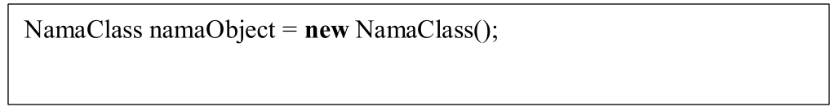
Object Instantiation
An Object is an instance of a class Instancation is done by calling the constructor using the keyword new
Contoh:
Mahasiswa mahasiswa1 = new Mahasiswa();
Mahasiswa ani = new Mahasiswa();

Slide 19
Example
public class Mahasiswa{
public String nim;
public String nama;
public String alamat;
public void cetakBiodataMahasiswa(){
System.out.println(“Biodata Mahasiswa”);
System.out.println(“Nim :” + nim);
System.out.println(“Nama :” + nama);
System.out.println(“Alamat :” + alamat);
}
}

Slide 20
Object Instancing
public class DemoMahasiswa{
public static void main(String[] args){
Mahasiswa mhs = new Mahasiswa();
mhs.nim = “14324”;
mhs.nama = “Very Sugiarto”;
mhs.alamat = “Malang”;
mhs.cetakBiodataMahasiswa();
}
}

Slide 21
Constructor
public class Donat{
public String topping;
}
public class Donat{
public String topping;
public Donat(){
}
}

Slide 22


Object Instancing
public class DemoDonat{
public static void main(String[] args){
Donat donat1 = new Donat();
donat1.topping = “Strawberry sprinkles”;
}
}

Slide 23
Constructor with parameters
Parameterized constructors are used to instantiate new objects with specific conditions/values. The Java compiler will not provide a default constructor (without parameters) if another constructor has already been created by the programmer
public class Donat{
public String topping;
Donat(String selectedTopping){
topping = selectedTopping;
}
}

Slide 24
Object Instancing
public class DemoDonat{
public static void main(String[] args){
Donat donat1 = new Donat(“Strawberry sprinkles”);
}
}

Slide 25
If a class does not have a constructor explicitly, then by default the Java compiler will provide a constructor without a paremeter
public class Donat{
public String topping;
}
public class DemoDonat{
public static void main(String[] args){
Donat donat1 = new Donat();
donat1.topping = “Strawberry sprinkles”;
}
}
public class Donat{
public String topping;
public Donat(){
}
}

Slide 26
public class Donat{
public String topping;
Donat(String selectedTopping){
topping = selectedTopping;
}
}
The Java compiler will not provide a default constructor (without parameters) if another constructor has already been created by the programmer
public class Donat{
public String topping;
Donat(String selectedTopping){
topping = selectedTopping;
}
}

Slide 27
Class Diagram
ClassName
attribute1: DataType1
attribute2: DataType2
method1(parameter1:tipeData1): returnType1
method2(): returnType2

Slide 28
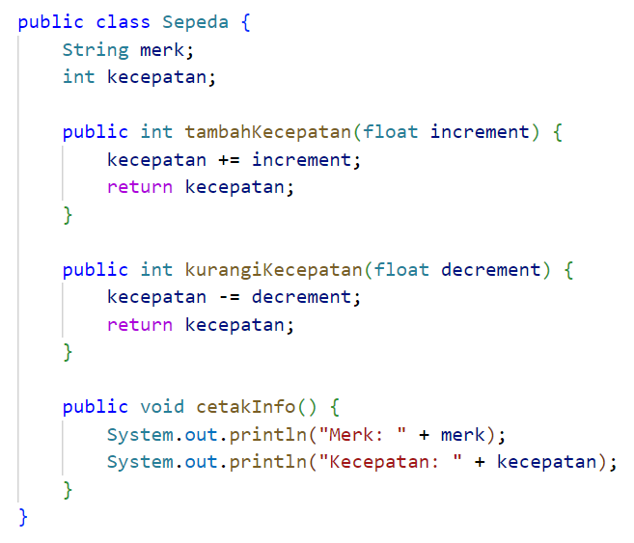
Sepeda
merk: String
kecepatan: int
tambahKecepatan(increment:int): int
kurangiKecepatan(decrement:int): int
cetakInfo(): void

Slide 29
Sepeda
merk: String
kecepatan: int
tambahKecepatan(): int
kurangiKecepatan(): int
cetakInfo(): void

Slide 30
From this
Look for any object in the real world as many as 5.
Write down the object's state/attributes and behavior/method. The more states and behaviors the better.
Example:Televisi
State:
Brand Screen size Channel Volume
Behavior:
Turn on Turn off Switch channels Increase volume Reduce volume

Slide 31
Task
To this
Create a class diagram for each class created in Task 01, Pay attention to best practices for naming classes, methods, and attributes (nouns/adjectives/works and capital letters) Find 1 example of a class diagram that you think is correct(picture)

